Slide 1
CAN THO UNIVERSITY
SCHOOL OF INFORMATION & COMMUNICATION TECHNOLOGY
INFORMATION TECHNOLOGY HIGH-QUALITY PROGRAM
GRADUATION THESIS
DEVELOPING A MUSHROOM IDENTIFICATION
APPLICATION
Advisor: Dr. Bùi Võ Quốc Bảo
Student: Nguyễn Quang Vinh (B2105727)
Notes:
Hello everyone, I am Quang Vinh, thanks for coming to my thesis defense presentation today, which is titled: “Developing a Mushroom Identification Application. Advised by Dr. BVQB

Slide 2
Content
Part 1: Introduction
Part 2: Theoretical basis & systems analysis
Part 3: Implementation
Part 4: Conclusion
Notes:
The presentation is organized into four parts:
1. The Introduction
2. Then Theoretical basis and systems analysis
3. Then Implementation
4. And the Conclusion

Slide 3
Part 1: Introduction

Slide 4
1.1. Problem Description
Mushroom identification is difficult for beginners due to subtle similarities.
Traditional methods require prior knowledge and are prone to errors.
Misidentification can cause serious health risks.
Growing interest in foraging has increased demand for reliable, accessible tools
Existing digital solutions are often limited by high cost or restrictive freemium models.
Notes:
Mushroom identification is known to be a difficult task for beginners - due how similar most species look, which can lead to possibly errors EVEN with prior knowledge.
And with the increase in interest for foraging hobby, there has been demand for accessible and beginner friendly tools
| |
without an expensive subscription or the restrictive freemium models

Slide 5
1.2. Purpose of the Study
The primary purpose of this study is to develop a beginner-friendly Android application that supports safe mushroom identification, promotes safe foraging practices and self-learning.
Notes:
And thus spawn this thesis which aims to develop a beginner-friendly Android application
| |
that supports mushroom identification and also promotes safe foraging practices, and self-learning for the hobby.

Slide 6
1.3. Objectives & Scope
Objectives:
Build an app that delivers reliable AI-based identification.
Combine image inference, search, history, and map features.
Design a fast client-server architecture with intuitive UI/UX.
Scope:
Android app using Flutter, server inference via PyTorch + Lightning.ai.
Local SQLite storage and a bundled JSON dataset.
Integration of iNaturalist API.
Notes:
Objectives:
1. Build an app that combine AI-based image identification that stored inferred result locally
2. with a search feature and interactable map DELIVERED with a fast client-server architecture and intuitive UI/UX
As for the scope:
1. The application is built with Flutter and integrated with the iNaturalist API.
2. With server inference via PyTorch and Lightning.ai
3. And local storage handled by SQLite and bundled JSON

Slide 7
Part 2: Theoretical basis & systems analysis

Slide 8
2.1. Key Technologies
Flutter/Dart: Cross-platform UI framework for fast Android development.
SQLite + JSON: Local data storage and offline mushroom information.
OpenStreetMap + iNaturalist API: Interactive map and community observations.
PyTorch + Kaggle: Training and testing the ViT model.
FastAPI + LitServe (Lightning.ai): Deploying and serving the model.
Notes:
Key technologies employed include:
1. Flutter and Dart for the UI
2. SQLite and JSON for local storage
3. OpenStreetMap (via CARTO Basemap) with the iNaturalist API for the interactive map feature
4. PyTorch and Kaggle for training and testing the AI model
5. And FastAPI with LitServe on Lightning.ai for deploying the AI model

Slide 9
2.2. Vision Transformer Model
Google/vit-base-patch16-224-in21k (Pre-trained on ImageNet-21k)
  Lightweight
  Good for subtle details and complex textures
  Higher accuracy than ResNet-50, EfficientNet, and MobileNet on the custom dataset
Notes:
The model used is Google – Vit-base-patch16, pretrained on ImageNet-21k dataset:
Chosen for being lightweight
While offer good performance on identifying subtle details and complex textures
And delivers better results compare to the 3 CNN models used as the baseline on the custom dataset

Slide 10
2.3. Dataset & Augmentation
Dataset: 80 classes × 200 images each (16,000 total).
Sources: iNaturalist, Kaggle, WildFoodUK, blogs.
Splits: 80% training, 10% validation, 10% test.
Augmentation: flips, rotate, brightness/contrast, hue/saturation, blur, noise, dropout, etc.
Notes:
The dataset consists of 80 classes with 200 samples each resulting in exactly 16,000 samples total
Sourced mostly from iNaturalist with the rest coming from Kaggle public dataset, WildFoodUK site and various other personal blogs.
The Dataset is split with the ratio 8:1:1 for the training, validation and test set respectively
Augmentation is applied to the train set just before training to improve generalization

Slide 11
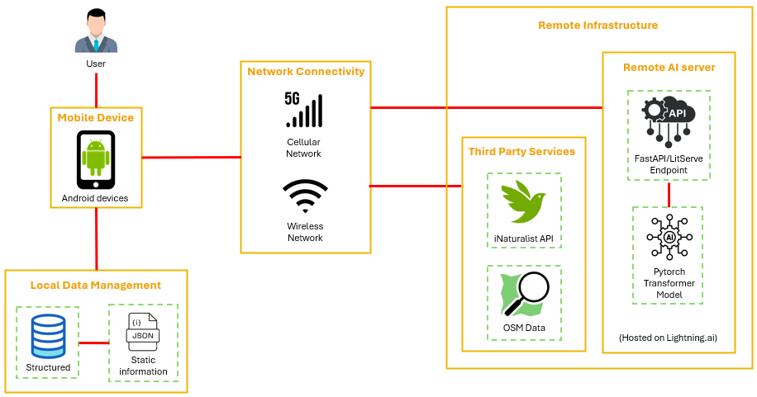
2.4. System Architecture Overview
Notes:
These subsequence slides show the overview of the system architecture, uses case and the workflow of the main features

Slide 12
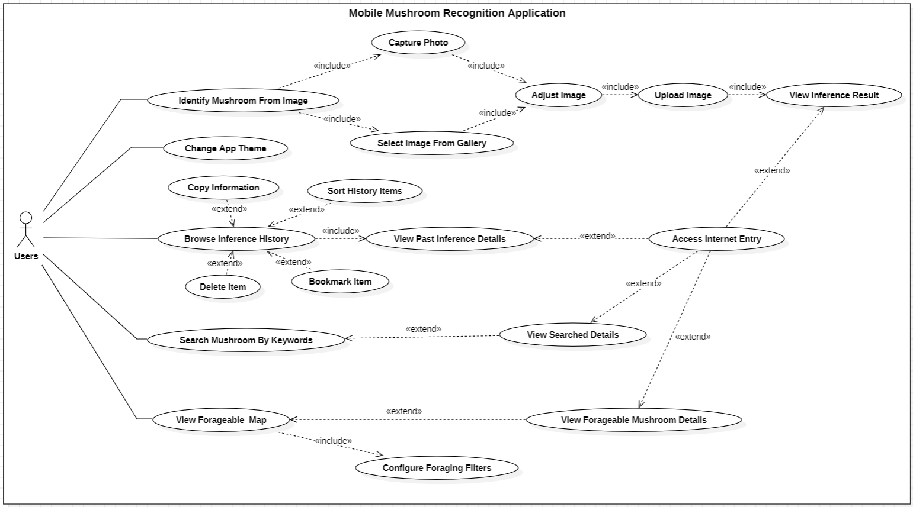
2.5. Use Case Overview
Notes:
Use case

Slide 13
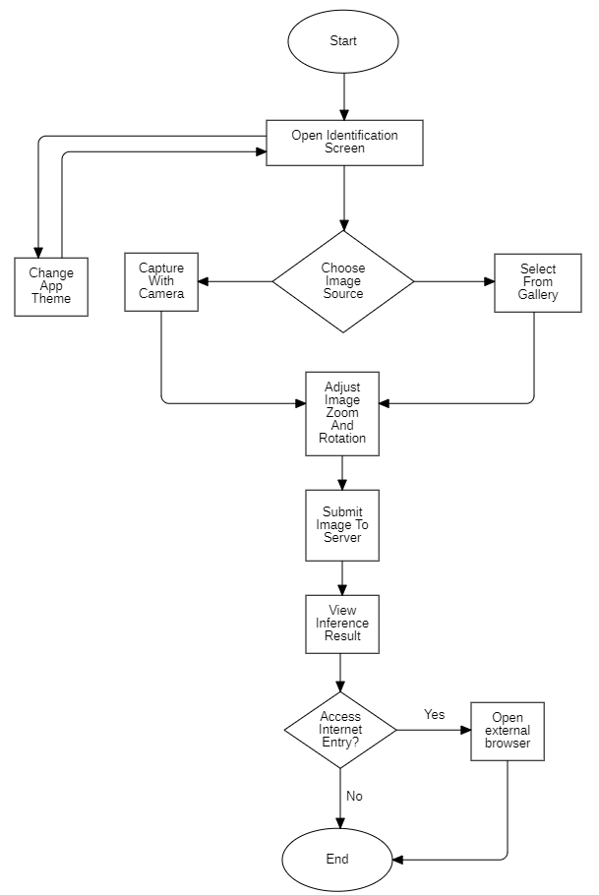
2.6. Mushroom Identification Workflows
Notes:
Image identification feature workflow

Slide 14
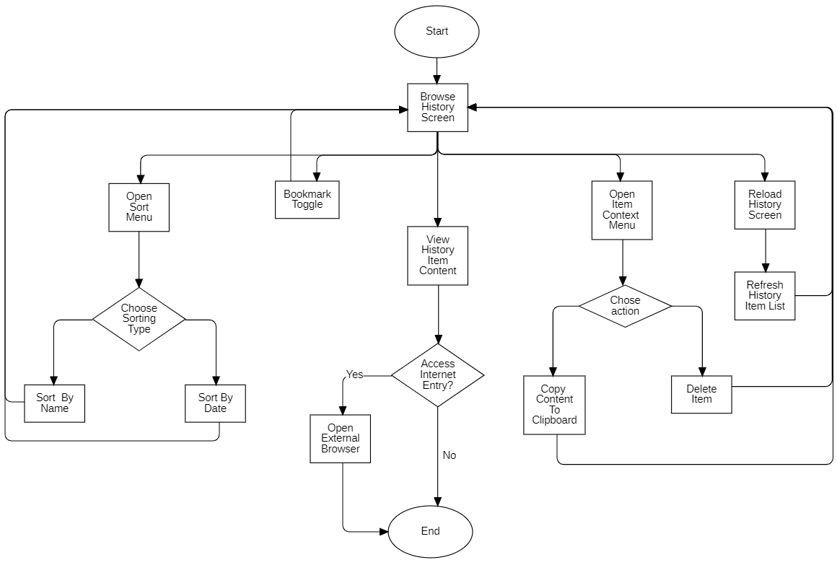
2.6. History Workflows
Notes:
History feature workflow

Slide 15
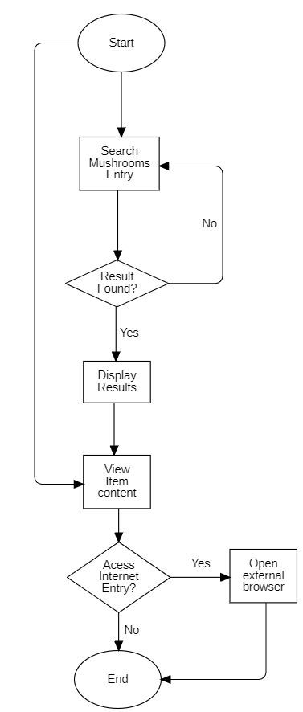
2.6. Search Workflows
Notes:
Search feature workflow

Slide 16
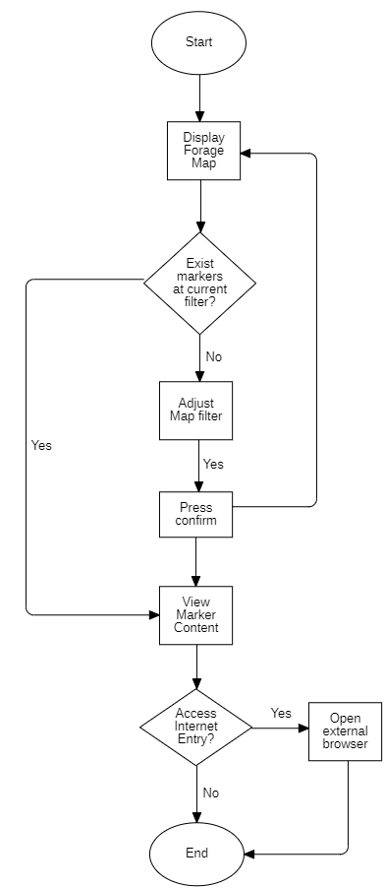
2.6. Forage Map Workflows
Notes:
Forage map feature workflow

Slide 17
Part 3: Implementation

Slide 18
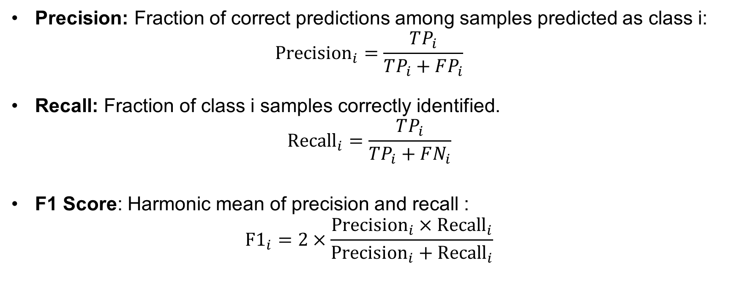
3.1. Model Evaluation Metrics
Precision: Fraction of correct predictions among samples predicted as class i:
$${\text{Precision}}_{i}=\frac{TP_{i}}{TP_{i}+FP_{i}}$$
Recall: Fraction of class i samples correctly identified.
$${\text{Recall}}_{i}=\frac{TP_{i}}{TP_{i}+FN_{i}}$$
F1 Score: Harmonic mean of precision and recall :
$${\text{F}\text{1}}_{i}=2×\frac{{\text{Precision}}_{i}×{\text{Recall}}_{i}}{{\text{Precision}}_{i}+{\text{Recall}}_{i}}$$
Notes:
The Model is evaluated on precision, recall and F1 score for each of the 80 classes

Slide 19
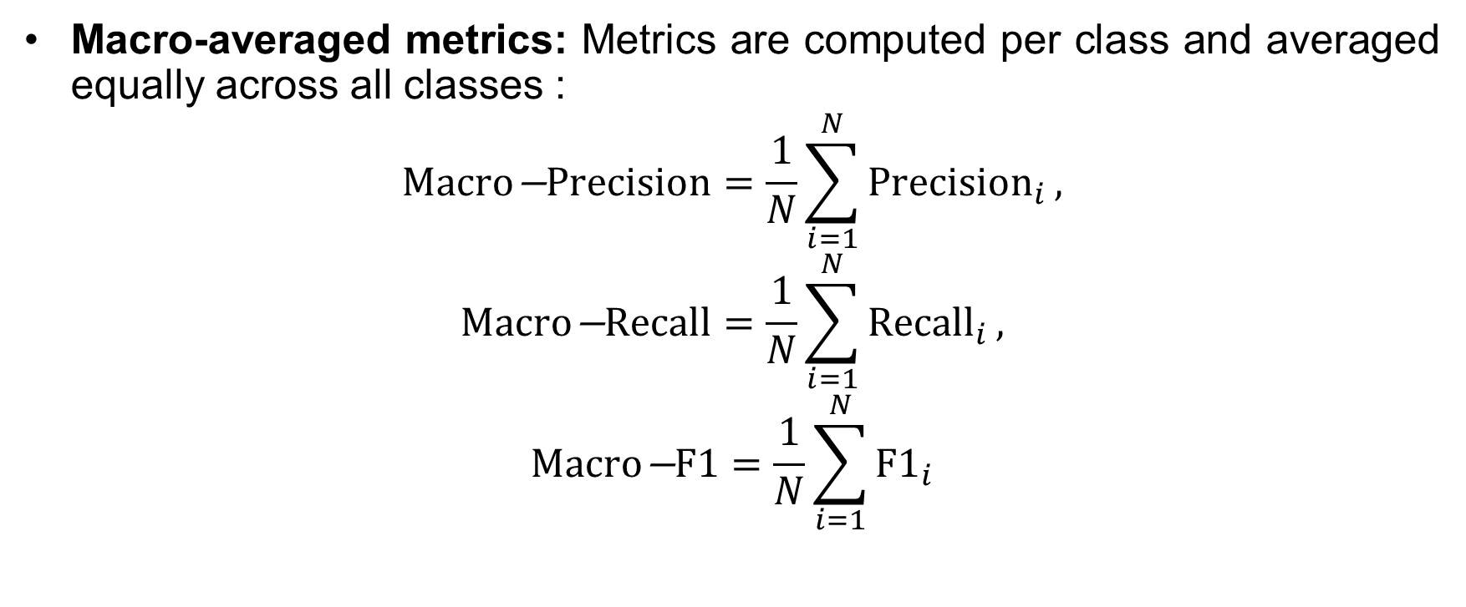
3.1. Model Evaluation Metrics
Macro-averaged metrics: Metrics are computed per class and averaged equally across all classes :
$$\text{Macro}\text{−}\text{Precision}=\frac{1}{N}\sum_{i=1}^{N}{{\text{Precision}}_{i}},$$
$$\text{Macro}\text{−}\text{Recall}=\frac{1}{N}\sum_{i=1}^{N}{{\text{Recall}}_{i}},$$
$$\text{Macro}\text{−}\text{F}\text{1}=\frac{1}{N}\sum_{i=1}^{N}{{\text{F}\text{1}}_{i}}$$
Notes:
then the average is calculated across all classes to ensure equal class contribution

Slide 20
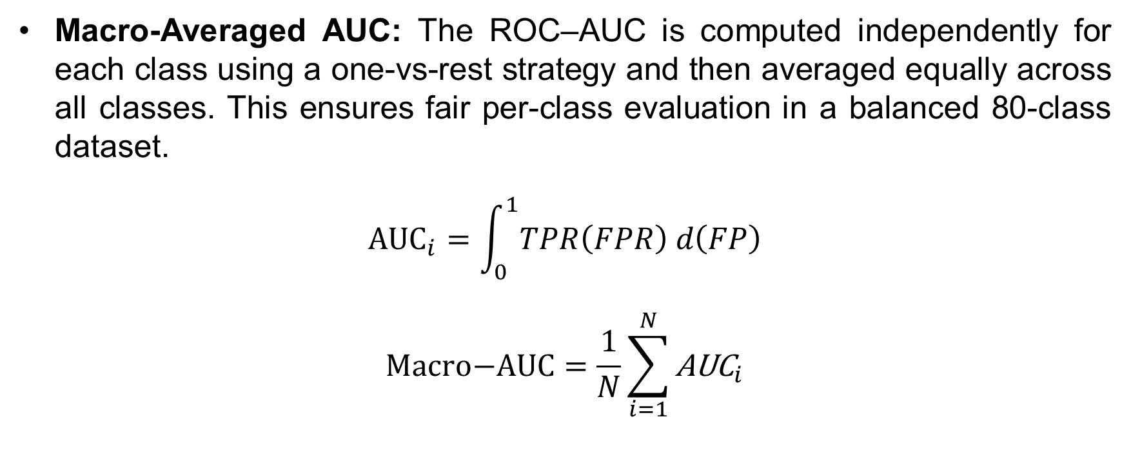
3.1. Model Evaluation Metrics
Macro-Averaged AUC: The ROC–AUC is computed independently for each class using a one-vs-rest strategy and then averaged equally across all classes. This ensures fair per-class evaluation in a balanced 80-class dataset.
$${\text{AUC}}_{i}=\int_{0}^{1}{TPR\left(FPR\right) d\left(FP\right)}$$
$$\text{Macro}\text{−}\text{AUC}=\frac{1}{N}\sum_{i=1}^{N}{{\text{AUC}}_{i}}$$
Notes:
The AUC value also follows the same macro-averaging approach across all classes

Slide 21
3.2. Model Results
Model | Macro-Averaged Precision | Macro-Averaged Recall | Macro-Averaged F1 Score | Macro-Averaged AUC
ViT | 0.89 | 0.88 | 0.88 | 0.998
ResNet-50 | 0.85 | 0.84 | 0.84 | 0.997
EfficientNetB4 | 0.84 | 0.83 | 0.83 | 0.996
MobileNetV3 | 0.83 | 0.82 | 0.82 | 0.995
Notes:
Result of the implementation the ViT model achieved consistently higher scores than all baseline models on the custom dataset

Slide 22
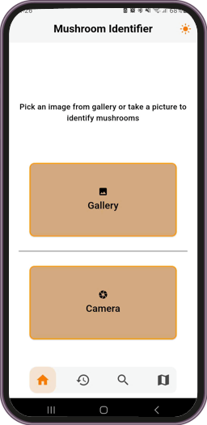
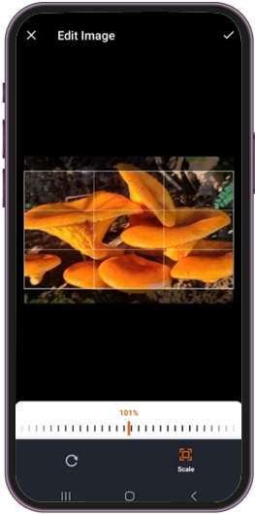
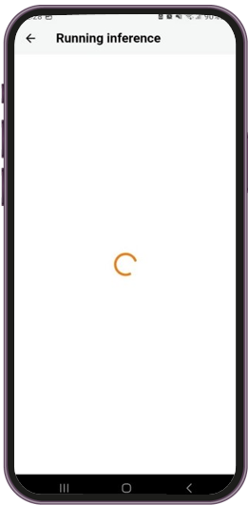
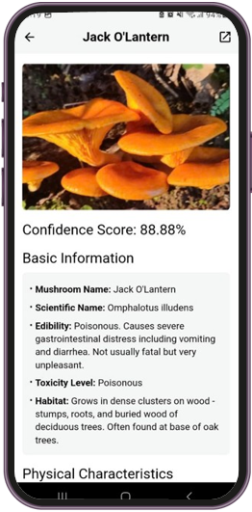
3.3. Mushroom Identification UI Implementation
Notes:
The following slides are result of the UI implementation for the Mushroom identification feature

Slide 23
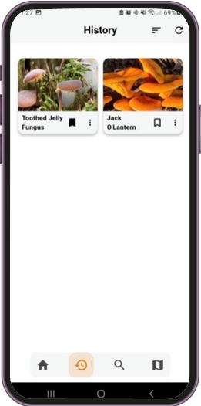
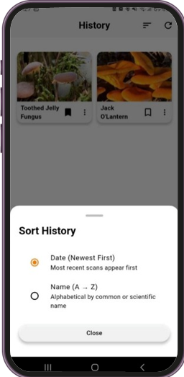
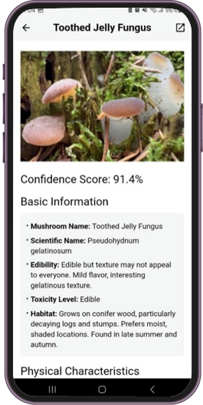
3.3. History UI Implementation
Notes:
History feature

Slide 24
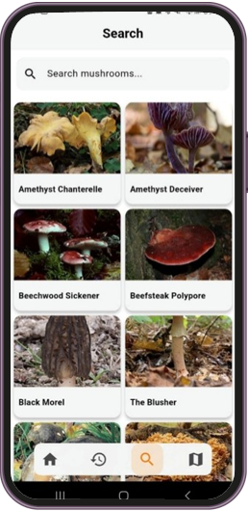
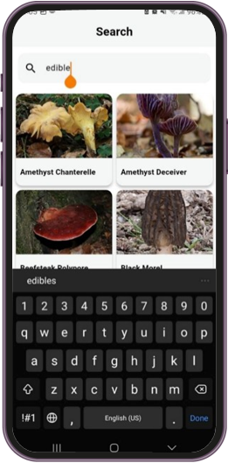
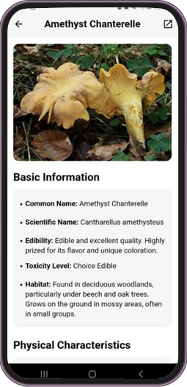
3.3. Search UI Implementation
Notes:
Search feature

Slide 25
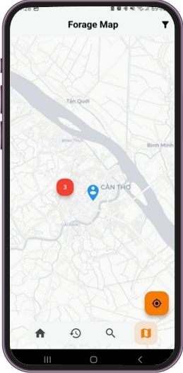
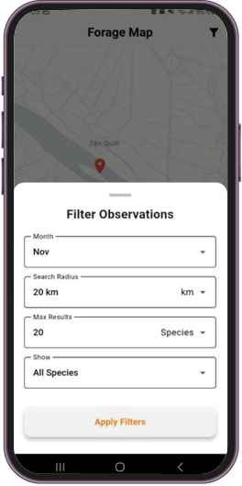
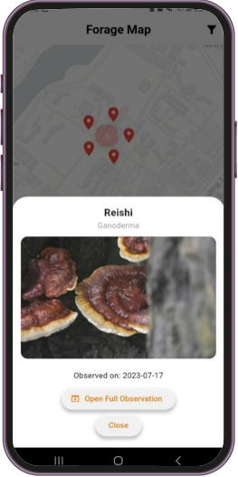
3.3. Forage Map UI Implementation
Notes:
And finally the forage map feature

Slide 26
Part 4: Conclusion

Slide 27
4.1. Achieved Results & Limitations
ACHIVED RESULTS:
Developed a beginner-friendly Android app for mushroom identification
Real-Time image recognition using a server-side ViT model with local storage
Keyword search powered by a bundled JSON dataset
Interactable map integrated with iNaturalist API.
CURRENT LIMITATIONS:
Limited and undiversified training data, overfitting not fully mitigated.
The current ViT model has yet achieved desired accuracy on all classes
Some features remain incomplete or underdeveloped
Notes:
ACHIVED:
In conclusion the thesis successfully delivered a beginner-friendly Android application that features:
1. real-time image recognition with local result storage,
2. keyword-searchable mushroom feature
3. and an interactive map integrated with iNaturalist API.
LIMITATIONS:
As for the limitations which include:
a relatively constrained dataset,
incomplete mitigation of overfitting,
low accuracy on certain classes,
Finally, some features remain underdeveloped.

Slide 28
4.2. Development Direction
Expand recognition to other wild forageable.
Use larger ViT variants for better performance.
Improve the dataset and augmentation strategy to reduce overfitting.
Upgrade keyword search to a chatbot.
Add user-submitted observation to iNaturalist feature to the forage map.
Notes:
For future improvements, I plan to:
1. Expand recognition feature other wild edibles.
2. Use larger ViT variants for better performance.
3. Improve the dataset and augmentation strategy to reduce overfitting.
4. Upgrade keyword search feature to a chatbot.
5. Add a user-submitted observation to iNaturalist feature to the forage map.

Slide 29
THANK YOU VERY MUCH
Can Tho University
Notes:
This concludes my presentation.
Thank you for listening

